Slide 1
CHAPTER - V
DATA LINK LAYER

Slide 2
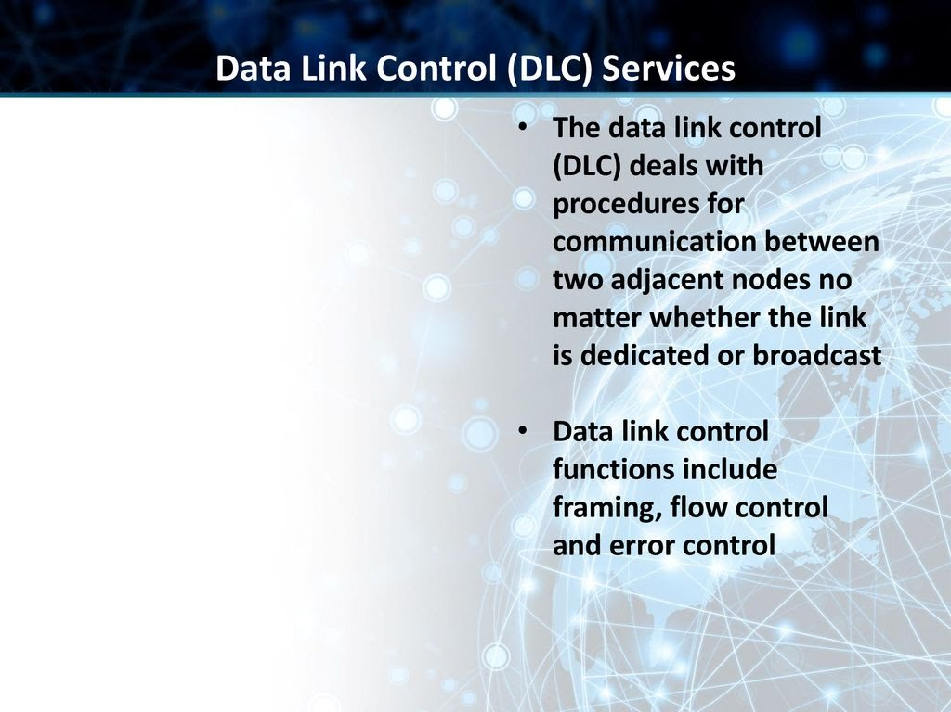

Slide 3
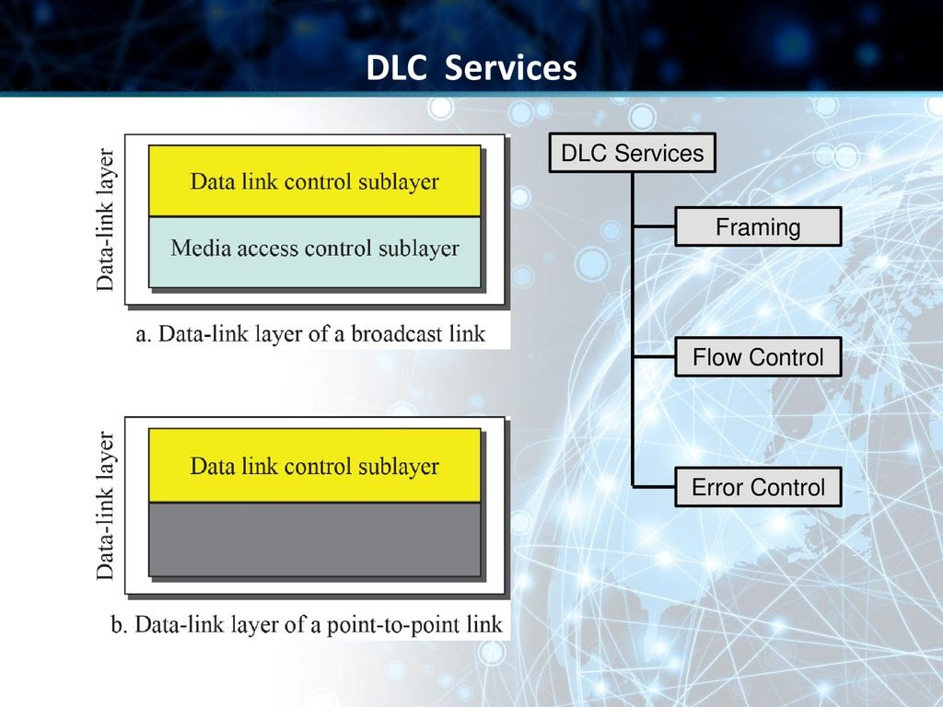

Slide 4
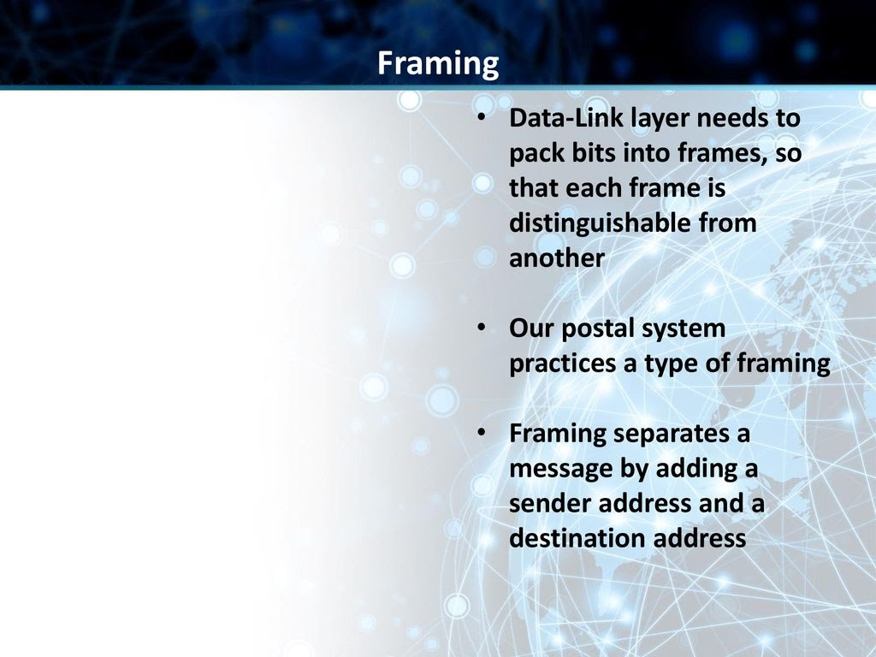
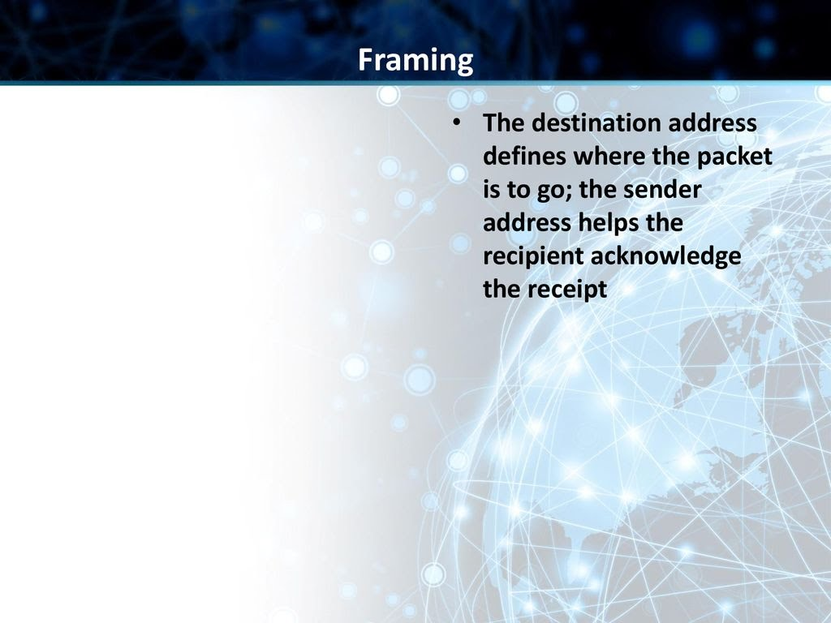
Framing in the data-link layer separates a message from one source to a destination by adding a sender address and a destination address

Slide 5
Frame Size
Frames can be of fixed or variable size. In fixed-size framing, there is no need for defining the boundaries of the frames; the size itself can be used as a delimiter. An example of this type of framing is the ATM WAN, which uses frames of fixed size called cells.
In variable-size framing, we need a way to define the end of one frame and the beginning of the next. Historically, two approaches were used for this purpose: a character-oriented approach and a bit-oriented approach.

Slide 6
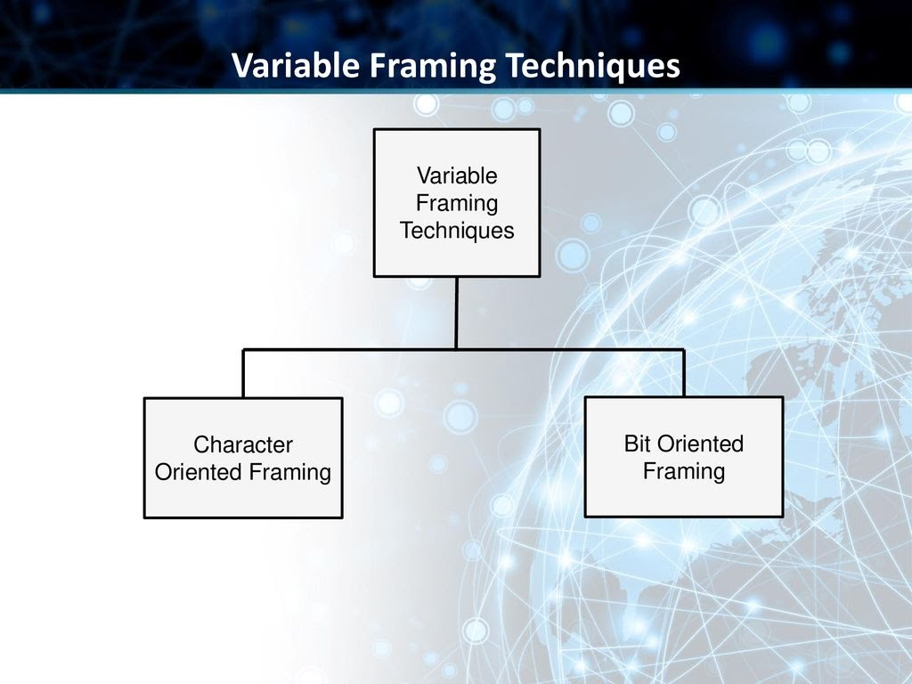

Slide 7
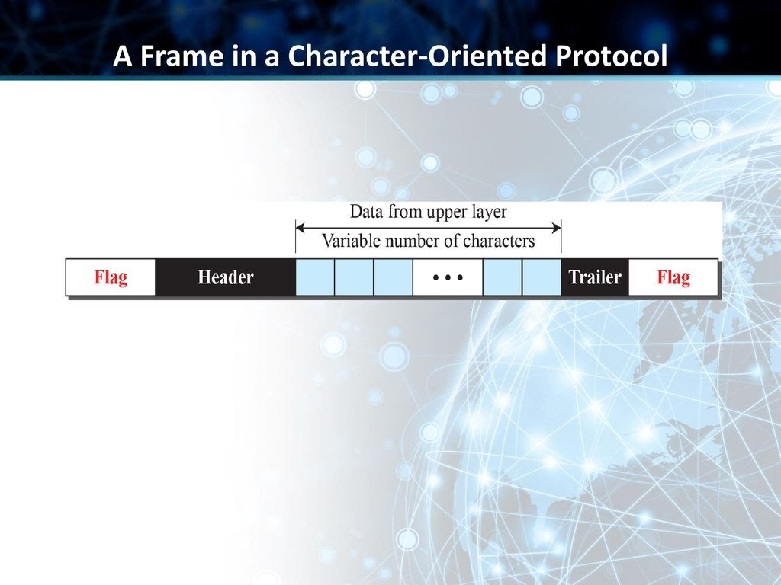

Slide 8
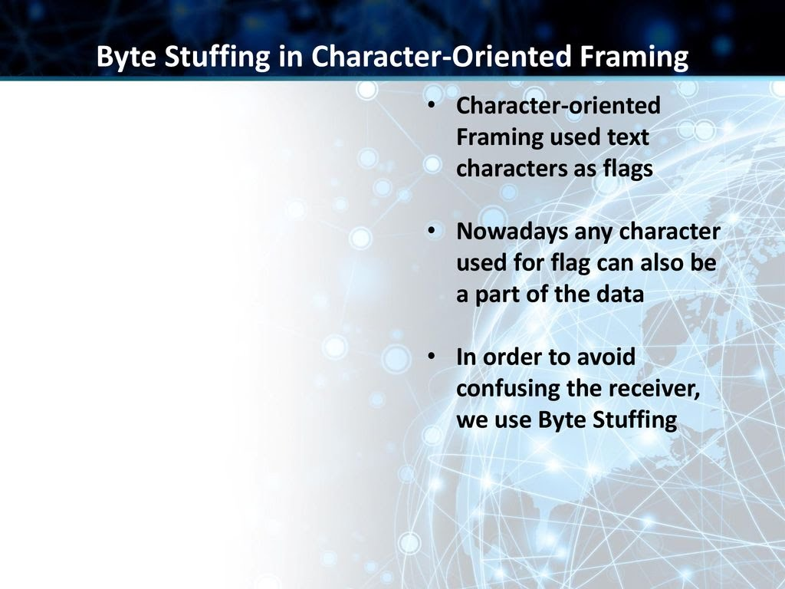
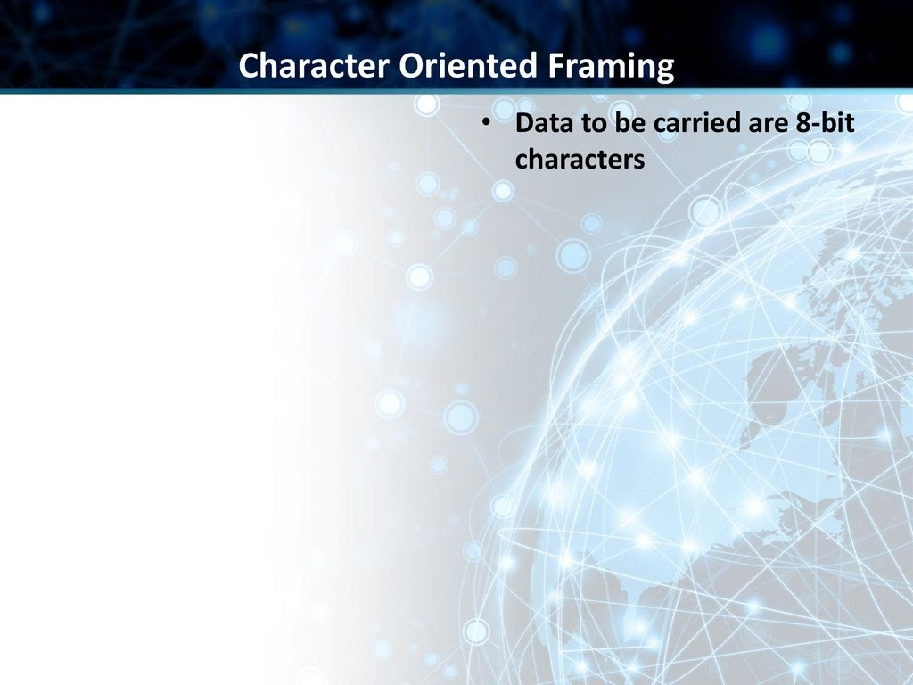

Slide 9
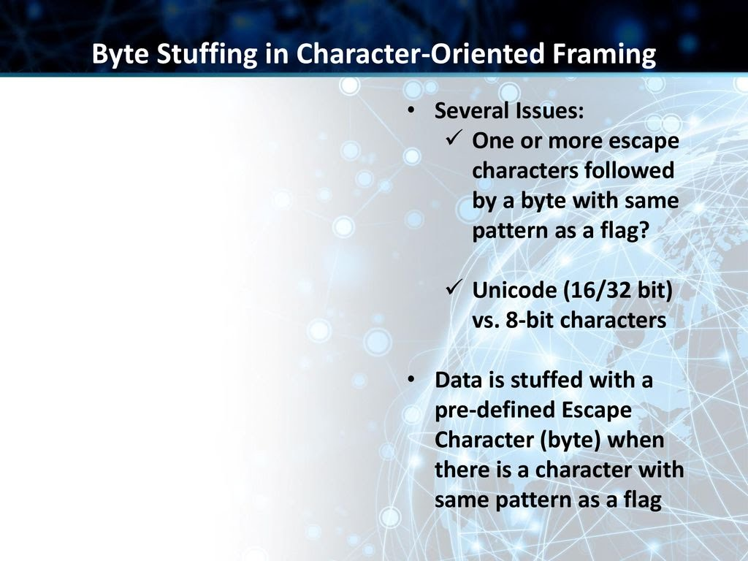
Byte stuffing is the process of adding one extra byte whenever there is a flag or escape character in the text.

Slide 10
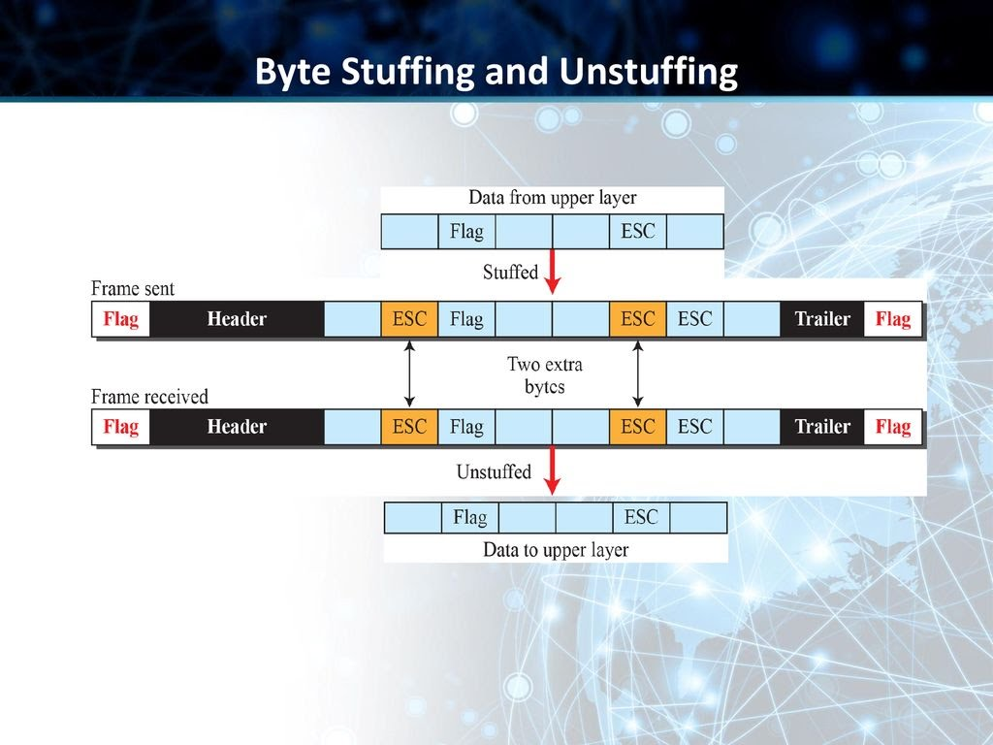

Slide 11
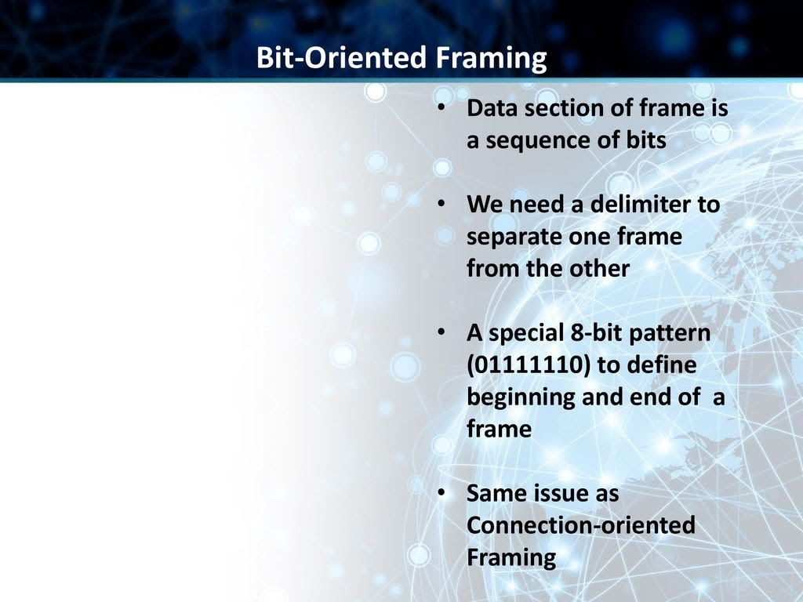
Bit stuffing is the process of adding one extra 0 whenever five consecutive 1s follow a 0 in the data, so that the receiver does not mistake the pattern 0111110 for a flag.

Slide 12
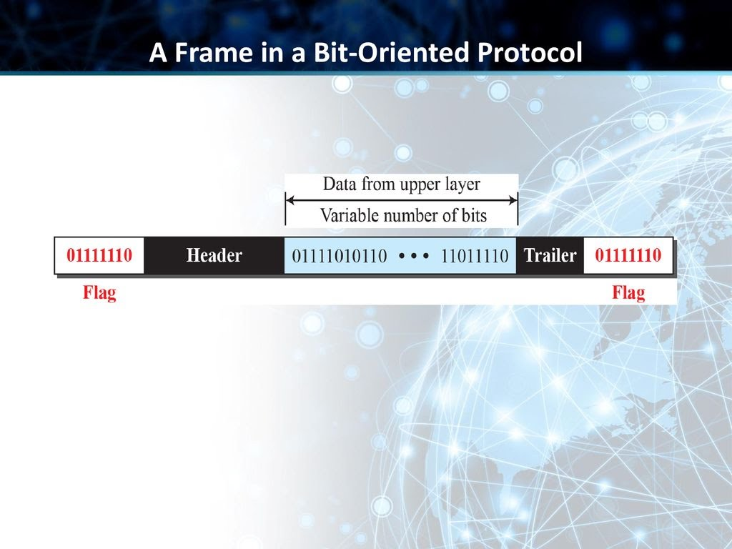

Slide 13
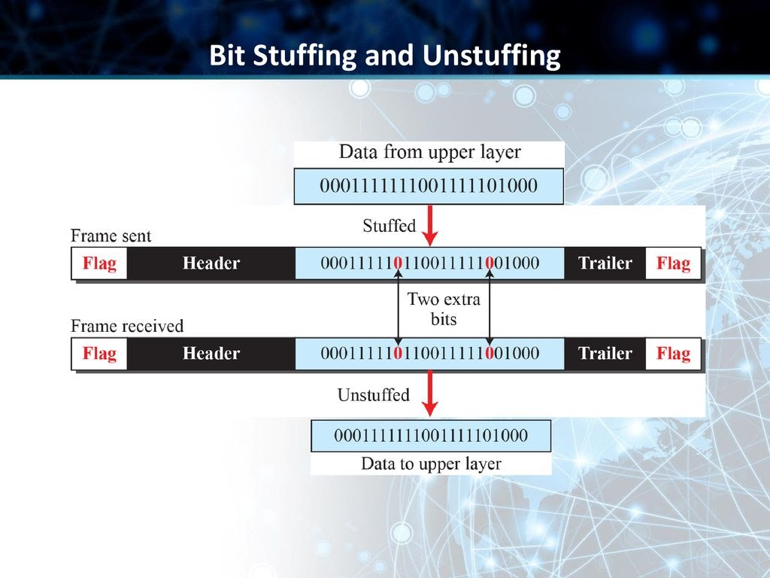

Slide 14
FLOW CONTROL
Whenever an entity produces items and another entity consumes them, there should be a balance between production and consumption rates.
If the items are produced faster than they can be consumed, the consumer can be overwhelmed and may need to discard some items.
If the items are produced more slowly than they can be consumed, the consumer must wait, and the system becomes less efficient.
Flow control is related to the first issue.

Slide 15
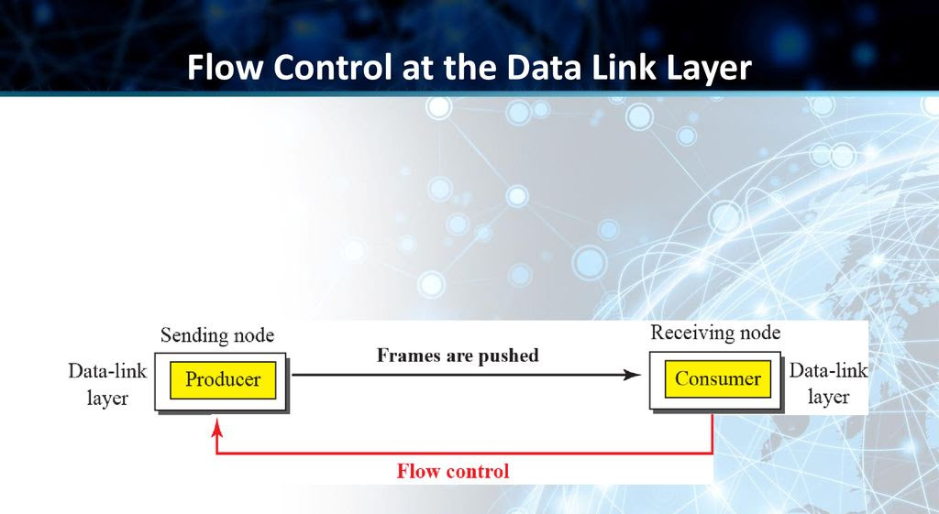
The data-link layer at the sending node tries to push frames toward the data-link layer at the receiving node. If the receiving node cannot process and deliver the packet to its network at the same rate that the frames arrive, it becomes overwhelmed with frames. Flow control in this case can be feedback from the receiving node to the sending node to stop or slow down pushing frames.

Slide 16
BUFFERS
Although flow control can be implemented in several ways, one of the solutions is normally to use two buffers.
One at the sending data-link layer and the other at the receiving data-link layer.
A buffer is a set of memory locations that can hold packets at the sender and receiver.
The flow control communication can occur by sending signals from the consumer to the producer.
When the buffer of the receiving data-link layer is full, it informs the sending data-link layer to stop pushing frames.

Slide 17
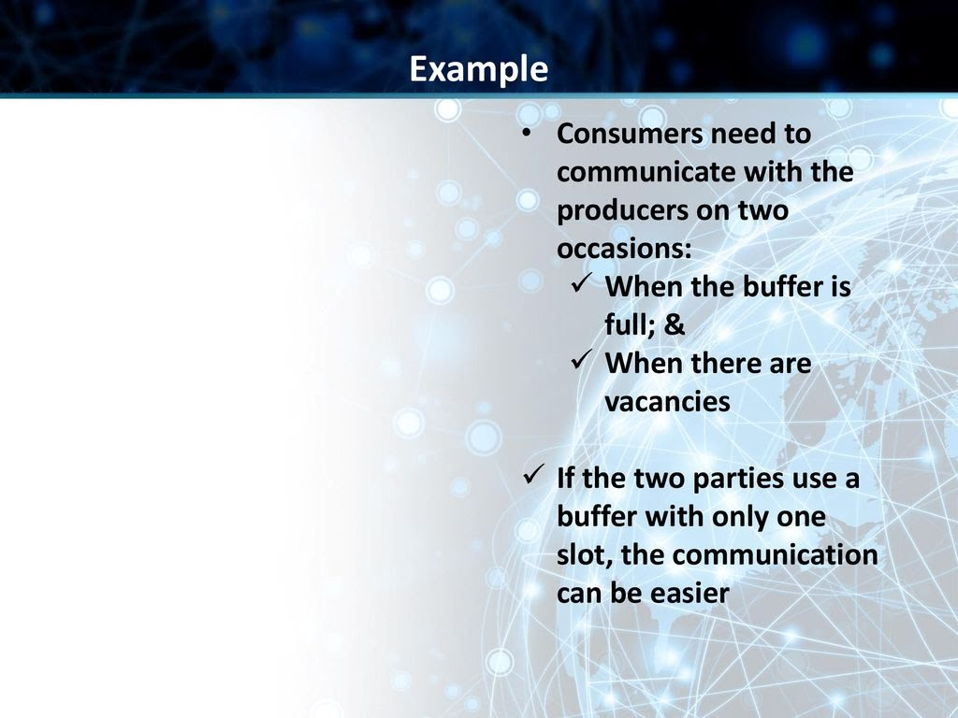

Slide 18
ERROR CONTROL
Since the underlying technology at the physical layer is not fully reliable, we need to implement error control at the data-link layer to prevent the receiving node from delivering corrupted packets to its network layer.

Slide 19
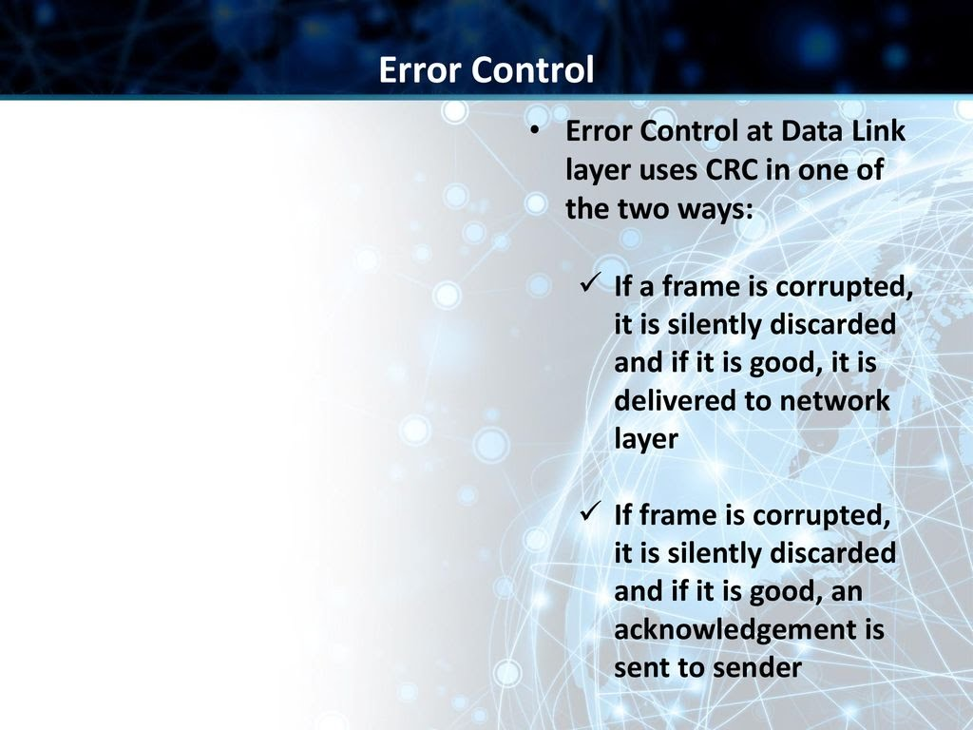
EXAMPLE: Wired LANs such as Ethernet

Slide 20
FLOW AND ERROR CONTROL
Flow and error control can be combined.
In a simple situation, the acknowledgment that is sent for flow control can also be used for error control to tell the sender the packet has arrived uncorrupted.
The lack of acknowledgment means that there is a problem in the sent frame.
A frame that carries an acknowledgment is normally called an ACK to distinguish it from the data frame.

Slide 21
DLC PROTOCOLS
A DLC protocol can be either CONNECTIONLESS OR CONNECTION-ORIENTED.
CONNECTIONLESS PROTOCOL
In a connectionless protocol, frames are sent from one node to the next without any relationship between the frames; each frame is independent. Note that the term connectionless here does not mean that there is no physical connection (transmission medium) between the nodes; it means that there is no connection between frames. The frames are not numbered and there is no sense of ordering. Most of the data-link protocols for LANs are connectionless protocols.

Slide 22
CONNECTION ORIENTED PROTOCOL
In a connection-oriented protocol, a logical connection should first be established between the two nodes (setup phase). After all frames that are somehow related to each other are transmitted (transfer phase), the logical connection is terminated (teardown phase). In this type of communication, the frames are numbered and sent in order. If they are not received in order, the receiver needs to wait until all frames belonging to the same set are received and then deliver them in order to the network layer. Connectionoriented protocols are rare in wired LANs, but we can see them in some point-to-point protocols, some wireless LANs, and some WANs.

Slide 23
DATA-LINK LAYER PROTOCOLS
SIMPLE
STOP AND WAIT
Go-Back-N
Selective-Repeat
IN USE
DISAPPEARED

Slide 24
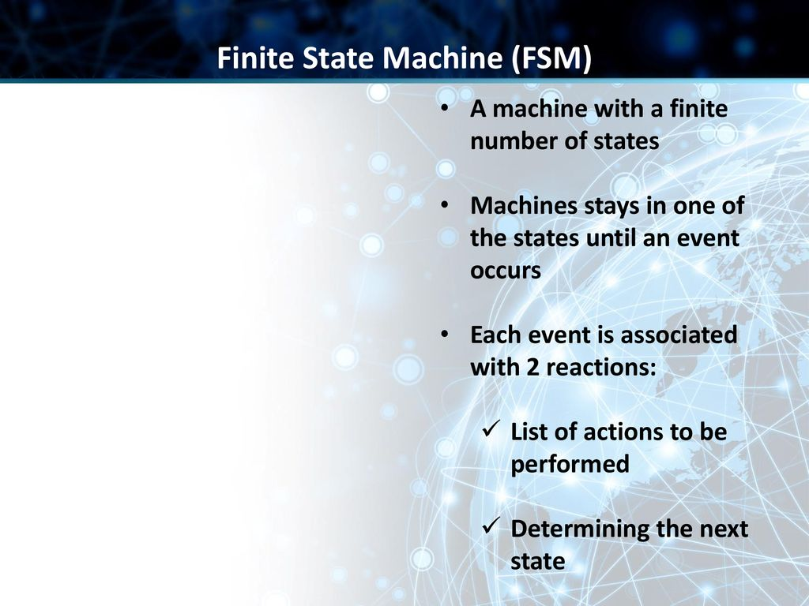

Slide 25
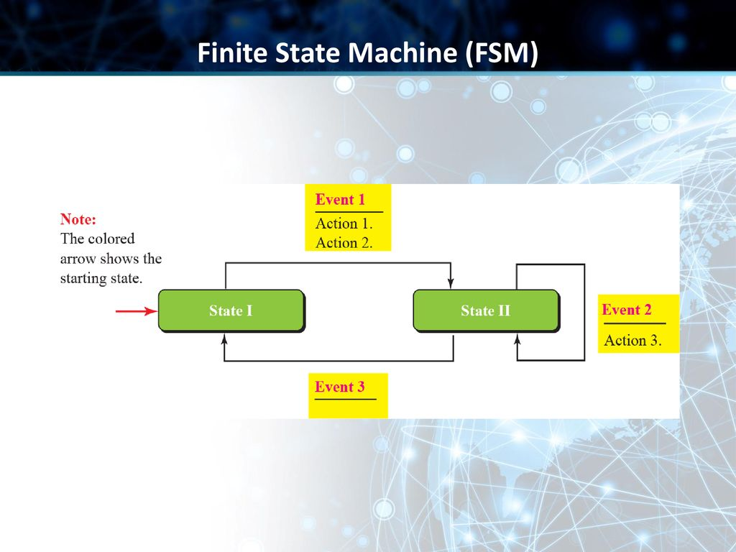

Slide 26
TYPES OF PROTOCOLS

Slide 27
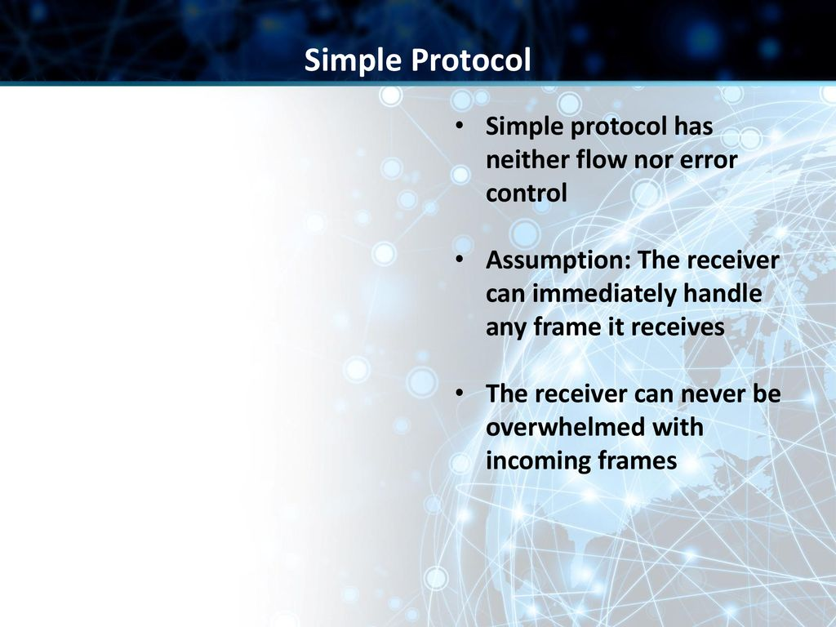

Slide 28
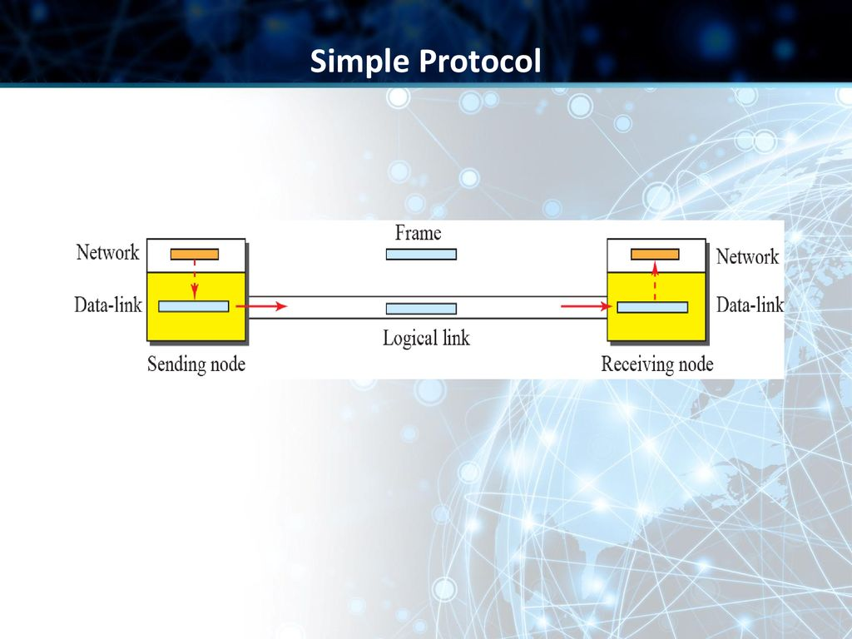
The data-link layer at the sender gets a packet from its network layer, makes a frame out of it, and sends the frame. The data-link layer at the receiver receives a frame from the link, extracts the packet from the frame, and delivers the packet to its network layer. The data-link layers of the sender and receiver provide transmission services for their network layers.

Slide 29
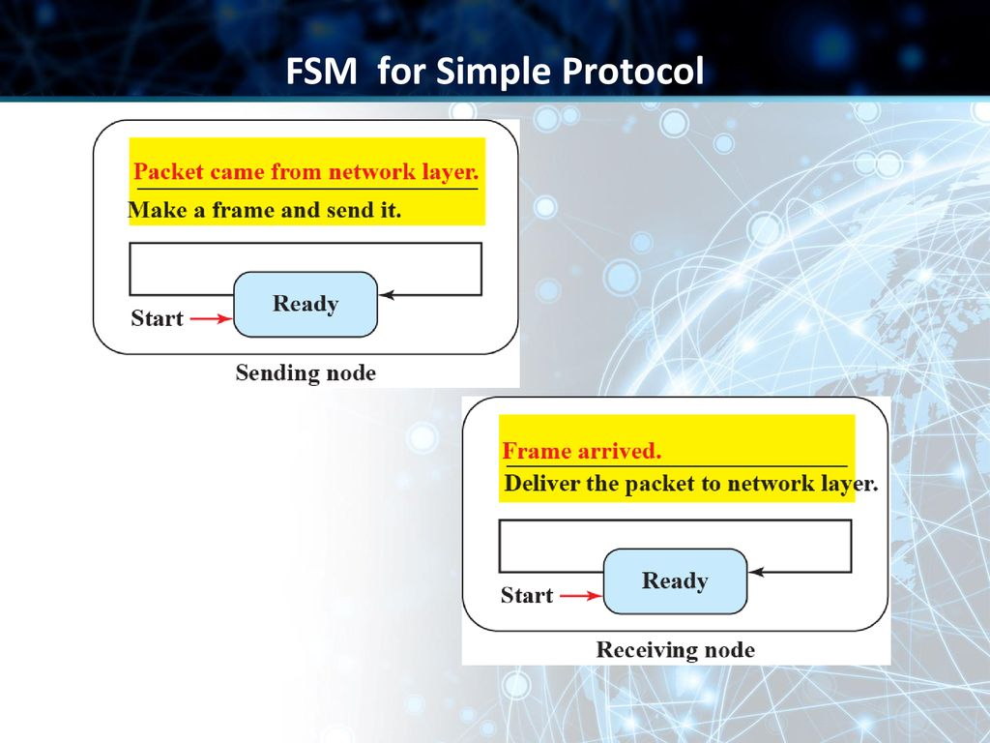
The sender site should not send a frame until its network layer has a message to send. The receiver site cannot deliver a message to its network layer until a frame arrives. We can show these requirements using two FSMs

Slide 30
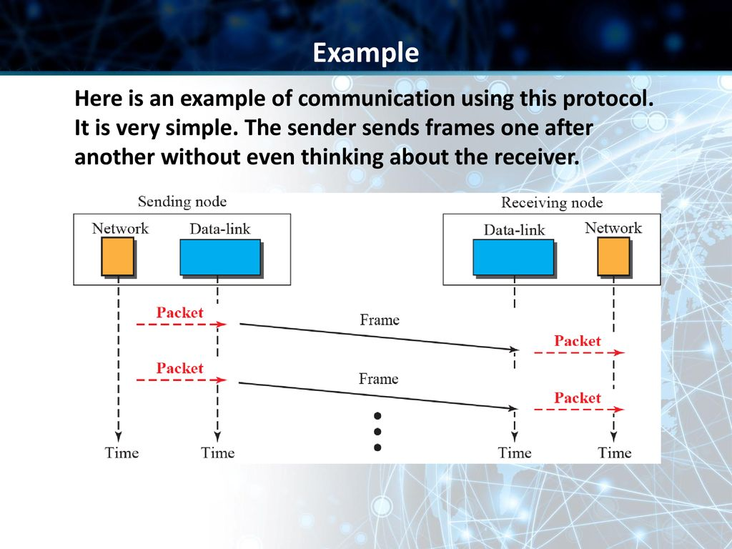

Slide 31
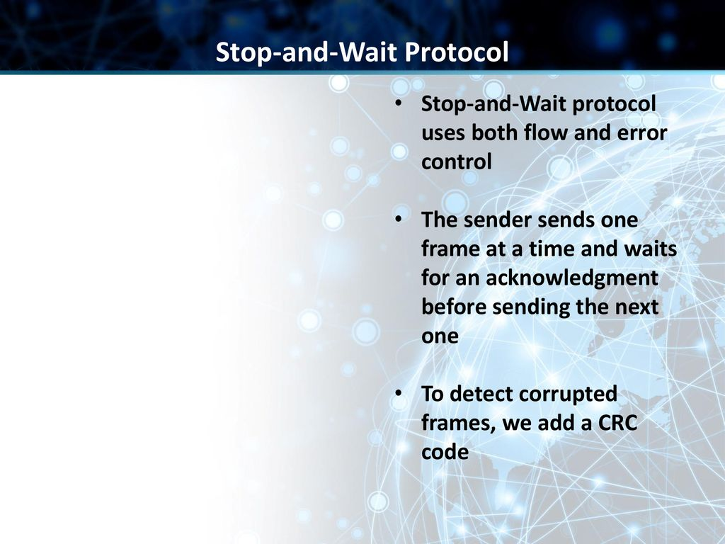

Slide 33
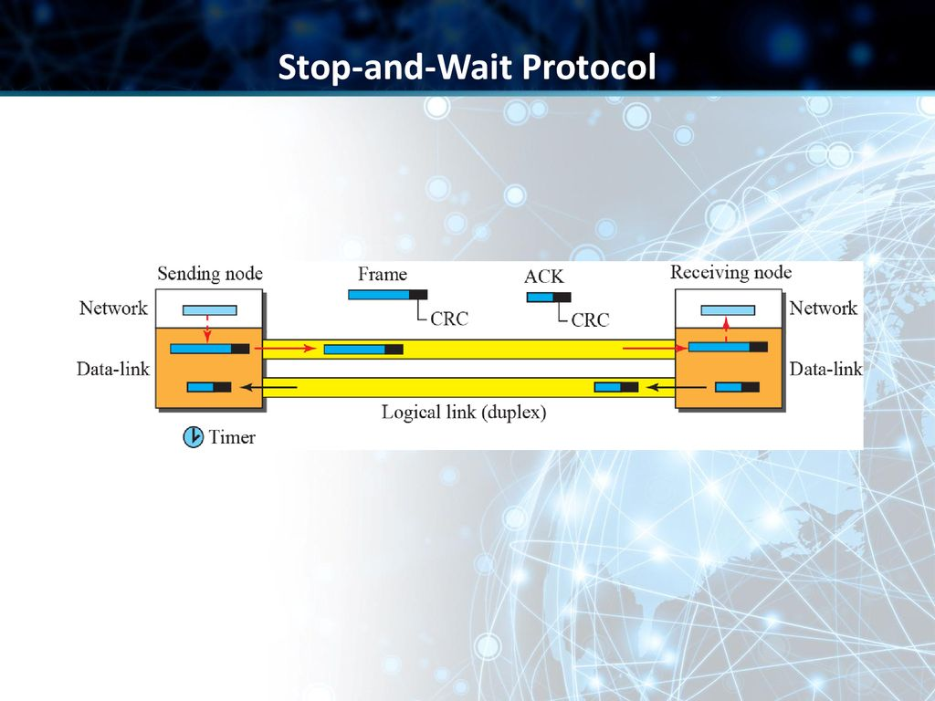

Slide 34
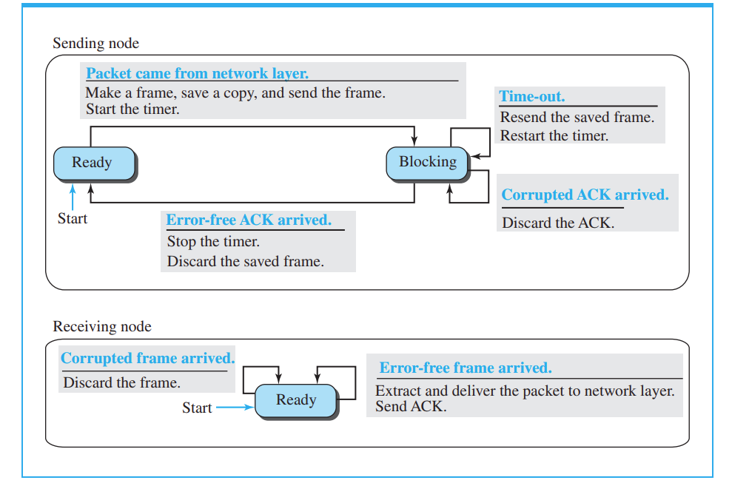

Slide 35
SENDER STATE:
The sender is initially in the ready state, but it can move between the ready and blocking state.
READY STATE:
When the sender is in this state, it is only waiting for a packet from the network layer. If a packet comes from the network layer, the sender creates a frame, saves a copy of the frame, starts the only timer and sends the frame. The sender then moves to the blocking state.
BLOCKING STATE:
When the sender is in this state, three events can occur:
a. If a time-out occurs, the sender resends the saved copy of the frame and restarts the timer.
b. If a corrupted ACK arrives, it is discarded.
c. If an error-free ACK arrives, the sender stops the timer and discards the saved copy of the frame. It then moves to the ready state.
RECEIVER:
The receiver is always in the ready state. Two events may occur:
a. If an error-free frame arrives, the message in the frame is delivered to the network layer and an ACK is sent.
b. If a corrupted frame arrives, the frame is discarded.

Slide 36
Example 11.3
The first frame is sent and acknowledged. The second frame is sent, but lost. After time-out, it is resent. The third frame is sent and acknowledged, but the acknowledgment is lost. The frame is resent. However, there is a problem with this scheme. The network layer at the receiver site receives two copies of the third packet, which is not right. In the next section, we will see how we can correct this problem using sequence numbers and acknowledgment numbers.

Slide 37
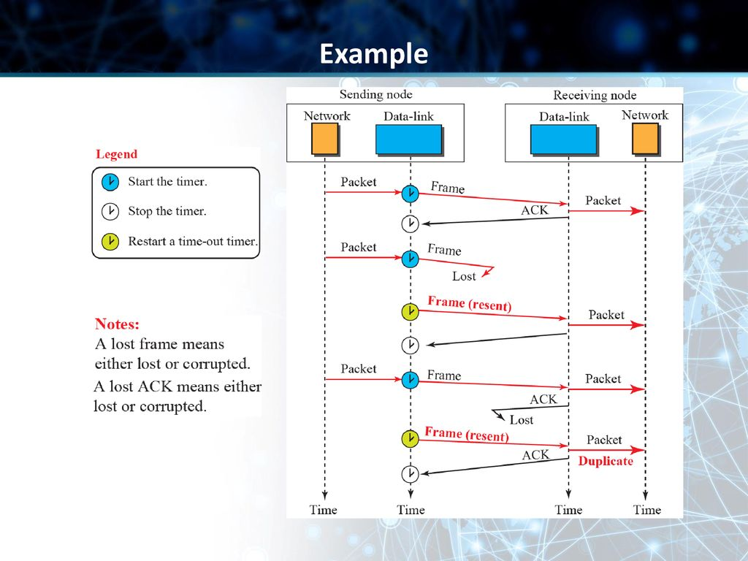

Slide 38
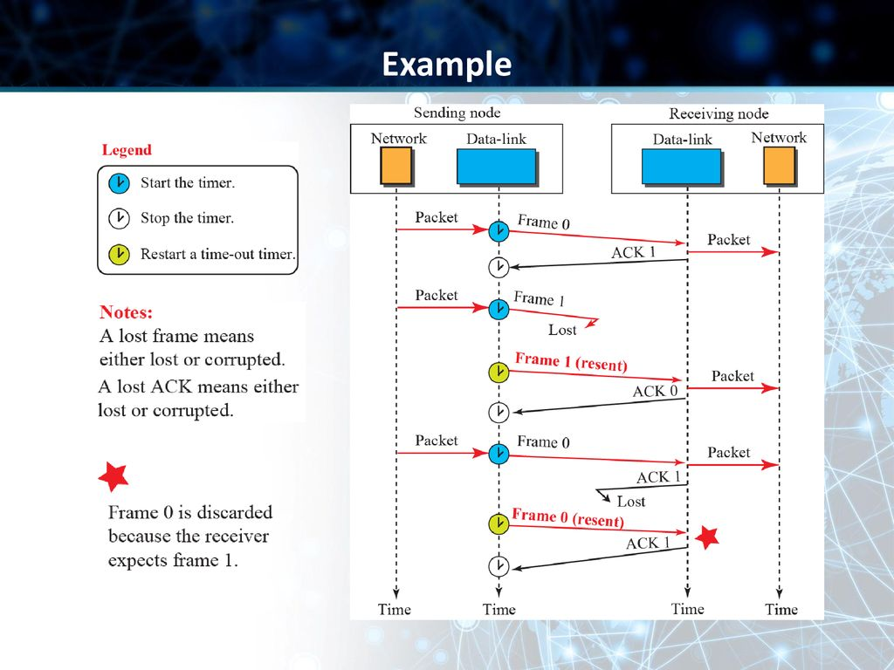

Slide 39
